Slide 1
Chương 5. Các kỹ thuật nâng cao chất lượng yêu cầu phần mềm
V.1. Kiểm soát thay đổi yêu cầu phần mềm
V.2. Các thuộc tính chất lượng của yêu cầu phần mềm
V.3. Truy hồi yêu cầu phần mềm (tracing)
V.4. Quản lý thay đổi yêu cầu phần mềm
V.5. Một số công cụ quản lý thay đổi yêu cầu phần mềm
1

Slide 2
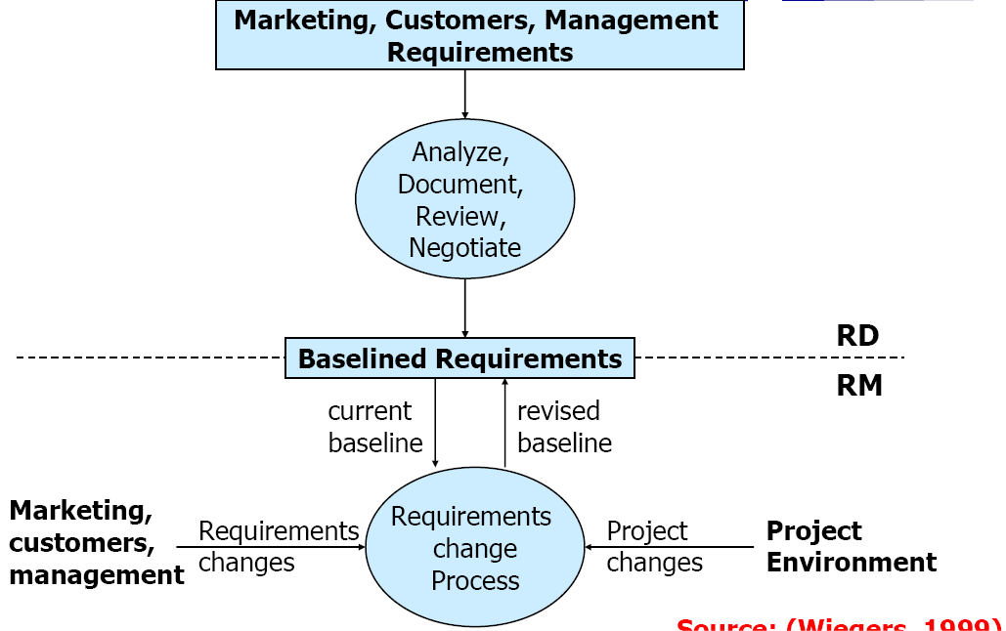
Requirements Development (RD) and Management (RM)
Introduction Traceability Baselines Change Management Requirements Management Tools
Source: Wiegers, 1999
3

Slide 3
Quality Requirements*
Product description
General requirements
Identifications and indications
Functionality
Reliability
Usability
Efficiency
Maintainability
Portability
User Documentation
Completeness
Correctness
Consistency
Understandability
Ease of overview
Programs and Data
Functionality
Reliability
Usability
Efficiency
Maintainability
Portability
* ISO/IEC 12119: 1994(E) (IEEE 1465-1998)

Slide 4
Baseline
Non-modifiable (read-only) version of a document
Describes a moment in time
May include multiple documents at the same time
Enables document comparison and management
Comes with a change history for the document
Information on objects, attributes, and links created, deleted, or edited since the creation of the baseline
Often also contains information on user sessions (when the document was opened, by whom…)
Requires access control
It is advisable to establish a baseline for a new document that
is imported into the document management system
In order not to lose any changes
4

Slide 5
Baseline for Requirements
Represents the set of functional and non-functional requirements that the development team has committed to implement in a specific release
Before going into the baseline, the requirements should be reviewed and approved by stakeholders
Once in the baseline, all changes should follow a defined change control process
Baseline
Different viewpoints
No formal documents
Always changing
Shared understanding
Configuration management
Change management
5

Slide 6
Baseline Usage
Baselines may be
Created
Complete image of requirements state at a given time
Deleted
Visualized
Possibility to go back
Compared
To see changes since a certain time
Copied
Signed
For authorization, contract
6

Slide 7
Chương 5. Các kỹ thuật nâng cao chất lượng yêu cầu phần mềm
V.1. Kiểm soát thay đổi yêu cầu phần mềm
V.2. Các thuộc tính chất lượng của yêu cầu phần mềm
V.3. Truy hồi yêu cầu phần mềm (tracing)
V.4. Quản lý thay đổi yêu cầu phần mềm
V.5. Một số công cụ quản lý thay đổi yêu cầu phần mềm
8

Slide 8
Requirements Engineering Activities
Requirements Engineering
Requirements Development
Requirements Management
Elicitation
Analysis
Specification
Verification
9

Slide 9
Chương 5. Các kỹ thuật nâng cao chất lượng yêu cầu phần mềm
V.1. Kiểm soát thay đổi yêu cầu phần mềm
V.2. Các thuộc tính chất lượng của yêu cầu phần mềm
V.3. Truy hồi yêu cầu phần mềm (tracing)
V.4. Quản lý thay đổi yêu cầu phần mềm
V.5. Một số công cụ quản lý thay đổi yêu cầu phần mềm
10

Slide 10
Why Do Requirements Change?
Change in software development: as inevitable as difficult to control!
Better understanding: new requirements become apparent
Everything else is changing…
Business
Context
Technologies
Markets
…
Possible responses to change
Add, modify, or remove requirements

Slide 11
Some Problems Due to Changing Requirements
Requirements changing towards the end of development without any impact assessment
Unmatched/outdated requirements specifications causing confusion and unnecessary rework
Time spent coding, writing test cases or documentation for requirements that no longer exist

Slide 12
A systematic approach to eliciting, organizing,
Requirements Management
and documenting the requirement of the system, and a process that establishes and maintains agreement between the customer and the project team on the changing requirements of the system.¹
[1] Leffingwell & Widrig 1999, p.16

Slide 13
Requirements Management Activities (1)
Requirements management includes all activities intended to maintain the integrity and accuracy of expected requirements
Manage changes to agreed requirements
Manage changes to baseline (increments)
Keep project plans synchronized with requirements
Control versions of individual requirements and versions of requirements documents
Manage relationships between requirements
Managing the dependencies between the requirements document and other documents produced in the systems engineering process
Track requirements status

Slide 14
Requirements Management Activities (2)
Requirements Management
Change control
Version control
Requirements
status tracking
Requirements tracing
Proposing changes
Analyzing impact
Making decisions
Updating
requirements documents
Updates plans
Measuring requirements volatility
Defining a version identification scheme
Identifying requirements document versions
Identifying individual requirement versions
Defining a
possible requirement statuses
Recording the status of each requirement
Reporting the status distribution of all requirements
Defining links to other requirements
Defining links to other system elements
Source: Wiegers, 1999

Slide 15
Requirements Development (RD) and Management (RM)
Source: Wiegers, 1999

Slide 16
From Management to Tools
Changes lead to a need for management
There is no management without:
Traceability
Baselines enabling comparisons
From a practical point of view, there is no traceability or management without appropriate tools
In theory, practice and theory are similar… But in practice they are different ☺

Slide 17
Requirements Change Factors (1)
Requirements errors, conflicts, and inconsistencies
May be detected at any phase (when requirements are analyzed, specified, validated, or implemented)
Evolving customer/user knowledge of the system
When the requirements are developed, customers/users simultaneously develop a better understanding of what they really need
Technical, schedule, or cost problems
Difficult to plan and know everything in advance
We may have to revisit the list of requirements and adapt it
to the current situation

Slide 18
Requirements Change Factors (2)
Changing customer priorities, new needs
May be caused by a change in the system environment (technological, business, political...), i.e., the context
Business and strategic goals may change
May be caused by the arrival of a new competitor
Laws and regulations may change
Collaborating systems may change
May also be caused by technology changes in the enterprise (migration to a new operating system, DBMS…)
May be caused by organizational changes (organizational
structure, business processes, employees…)

Slide 19
Requirements Volatility
Requirements continuously change
While the requirements are being elicited, analyzed, specified, and validated and after the system has gone into service
Some requirements are usually more subject to change than others
Stable requirements are concerned with the essence of a system and its application domain
Derived from the client’s principal business activities or the domain model
They change more slowly than volatile requirements
E.g., a hospital will always have doctors, nurses, patients…
Volatile requirements are specific to the instantiation of the system in a
particular environment for a particular customer at a particular time
E.g., in a hospital, we can think of requirements related to the policies of the government health system

Slide 20
Types of Volatile Requirements
Mutable requirements
These are requirements which change because of changes to the environment in which the system is operating
Emergent requirements
These are requirements which cannot be completely defined when the system is specified but which emerge as the system is designed and implemented
Consequential requirements
These are requirements which are based on assumptions about how the system will be used
Once the system is in place, some of these assumptions will be wrong
Compatibility requirements
These are requirements which depend on other equipment, technology, or processes

Slide 21
Expectations of Requirements Management (1)
Identification of individual requirements
Traceability from highest level requirements to implementation
Established via links through a requirements database
Links between requirements and design models, tests, code…
Coverage and consistency analysis
What are the traceability policies? What types of links? From where? To where?
Impact assessments of proposed changes
Analysis tools let you see which other requirements (and other linked artifacts) will be affected by a change

Slide 22
Expectations of Requirements Management (2)
Controlled access to current project information
A shared database ensures that all users are working with current data (consistency, parallel access)
A central repository allows all users to see the information that they need to see (visibility)
Change control
Change proposal system implements controlled process for managing change
How do we collect, document, and address changes?
Deployment of required tool support
To help manage requirements change

Slide 23
Identification of Requirements
It is essential for requirements management that every requirement has a unique identification
The most common approach is requirements numbering
based on chapter/section in the requirements document
There are several problems with this approach
Numbers cannot be unambiguously assigned until the document is complete
Assigning chapter/section numbers is an implicit classification of the requirements ➔ may mislead readers of the document into thinking that the most important relationships are with requirements in the same section

Slide 24
Requirements Identification Techniques
Dynamic renumbering
Some word processing systems allow for automatic renumbering of paragraphs and the inclusion of cross references
As you reorganise your document and add new requirements, the system keeps track of the cross references and automatically renumbers your requirements depending on its chapter, section, and position within the section
Database record identification
When a requirement is identified, it is entered in a requirements database and a database record identifier is assigned which is then used for all subsequent references to the requirement
Symbolic identification
Requirements can be identified by giving them a symbolic name which is associated with the requirement itself (e.g., SEC1, SEC2, SEC3… may be used for requirements which relate to system security)

Slide 25
Requirements Have Attributes!
Apart from an identifier, requirements should have attributes that establish context and background, and go beyond the requirement description
For filtering, analysis, metrics…
Creation date, Last update, Author, Stakeholders (Owners / Source)
Version number
Status, Priority, Importance, Stability
Rationale, Comments
Acceptance criteria
Subsystem / Product release number
…
The more complex the project, the richer the attributes…
Many attributes are predefined in RM tools, others are defined by requirements engineers as required by the project

Slide 26
Requirements Attributes
Classes and attributes of a requirements management database
SYS_MODELS
RE QUIREMENT
SOURCE_LIST
Model: MODEL Description: TEXT Next: MODEL | NULL
Identifier: TEXT
Statement: TEXT| GRAPHIC Date_entered: DATE Date_changed:DATE Sources: SOURCE_LIST
Rationale: REQ_RATIONALE Status: STATUS
Dependents: REQ_LIST Is_dependent_on: REQ_LIST Model_links: SYS_MODELS Comments: TEXT
People: TEXT Documents: TEXT Reqs: REQ_LIST
RE Q_LIST
RE Q_RATIONALE
Req: REQUIREMENT
Description: TEXT Next: REQUIREMENT
| NULL
Rationale: TEXT Diagrams: GRAPHIC Photos: PICTURE
Select only the necessary attributes!

Slide 27
Requirements Status
Help manage the requirement lifecycle
Their number and nature depend on the process in place
Example of a set of statuses:
Proposed: by some stakeholder
Approved: part of baseline, committed to implement
Rejected: after evaluation
Implemented: designed and implemented
Verified: Relevant tests have passed
Deleted: Removed from list
RM includes amongst its tasks the tracking of the status of all requirements during the project

Slide 28
Version Control
Another essential aspect of requirements management
Every version of a requirement needs to be uniquely identified
The last version of a requirement must be available to all team members
Changes need to be documented and clearly communicated
A version identifier must be updated with every change to the requirement
Requirements documents should include
A revision history: changes, dates, by whom, why...
Standard markers for revisions (e.g., strikethrough or underlined text, coloring, line markers…)
Version control tool may be used
To store and manage the revision history
To store justifications (to add, modify, delete, reject a requirement)

Slide 29
Chương 5. Các kỹ thuật nâng cao chất lượng yêu cầu phần mềm
V.1. Kiểm soát thay đổi yêu cầu phần mềm
V.2. Các thuộc tính chất lượng của yêu cầu phần mềm
V.3. Truy hồi yêu cầu phần mềm (tracing)
V.4. Quản lý thay đổi yêu cầu phần mềm
V.5. Một số công cụ quản lý thay đổi yêu cầu phần mềm
30

Slide 30
Traceability Quotes (1)
Requirements traceability refers to the ability to describe and follow the life of a requirement, in both forwards and backwards direction (i.e., from its origins, through its development and specification, to its subsequent deployment and use, and through all periods of ongoing refinement and iteration in any of these phases)”.¹
A software requirements specification is traceable if the origin of each of its requirements is clear and if it facilitates the referencing of each requirement in future development or enhancement documentation.²
Traceability gives essential assistance in understanding the relationships that exist within and across software requirements, design, and implementation.³
A link or relationship defined between entities.⁴
[1] Gotel & Finkelstein, 1994; [2] IEEE Standard 830-1998; [3] Palmer, 2000; [4] Watkins and Neal, 1994

Slide 31
Traceability Quotes (2)
Traceability is often mandated by contracts and standards.¹
E.g., military and aerospace
One cannot manage what cannot be traced.²
Traceability information helps assess the impact of changes to requirements, connecting these requirements as well as requirements for other representations of the system.³
Traceability is a property of a system description technique that allows changes in one of the three system descriptions – requirements, specifications, implementation – to be traced to the corresponding portions of the other descriptions. The correspondence should be maintained through the lifetime of the system.⁴
[1-2] Watkins and Neal, 1994; [3] Kotonya and Sommerville, 1998; [4] Greenspan, McGowan, 1978

Slide 32
Importance of Traceability (1)
Requirements cannot be managed effectively without requirements traceability
A requirement is traceable if you can discover who suggested the requirement, why the requirement exists, what requirements are related to it, and how that requirement relates to other information such as systems designs, implementations and user documentation

Slide 33
Importance of Traceability (2)
Benefits of traceability
Prevents losing knowledge
Supports the verification process (certification, localization of defects)
Impact analysis
Change control
Process monitoring (e.g., missing links indicate completion level)
Improved software quality (make changes correctly and completely)
Reengineering (define traceability links is a way to record reverse engineering knowledge)
Reuse (by identifying what goes with a requirement: design, code…)
Risk reduction (e.g., if a team member with key knowledge leaves)

Slide 34
Traceability Difficulties
Various stakeholders require different information
Huge amount of requirements traceability information must be tracked and maintained
Manual creation of links is very demanding
Likely the most annoying problem
Specialized tools must be used
Integrating heterogeneous models/information from/to different sources (requirements, design,
tests, code, documentation, rationales…) is not trivial
Requires organizational commitment (with an understanding of the potential benefits)

Slide 35
Backward and Forward Traceability (1)
Backward traceability
To previous stages of development
Depends upon each element explicitly referencing its source in earlier documents
Forward traceability
To all documents spawned by a document
Depends upon each element in the document having a unique name or reference number
Business plan
Requ irements Document Design Specification
Forward-fromtraceability
Backward-from traceability Backward-to traceability
Forward-to traceability
Source of figure: Kotonya and Sommerville

Slide 36
Backward and Forward Traceability (2)
Top to bottom from requirements’ point of view
Forward-to traceability
Links other documents (which may have preceded the requirements document) to relevant requirements
Help validation
Help evaluate which requirements are affected by changes to users’ needs
Forward-from traceability
Links requirements to the design and implementation components
Help assure that all requirements have been satisfied

Slide 37
Backward and Forward Traceability (3)
Bottom to top from requirements’ point of view
Backward-to traceability
Links design and implementation components back to requirements
Help determine why each item is designed/implemented
Backward-from traceability
Links requirements to their sources in other documents or people
Help validation
Help evaluate how changes to requirements impact stakeholders needs

Slide 38
Types of Traceability (1)
Requirements – source traceability
Links requirements with a person or document
Requirements – rationale traceability
Requirements – requirements traceability
Links requirements with other requirements which are, in some way, dependent on them
Requirements – architecture traceability
Links requirements with the subsystems where these requirements are implemented (particularly important where subsystems are being developed by different subcontractors)
Requirements – design traceability
Links requirements with specific hardware or software components in the system which are used to implement the requirement

Slide 39
Types of Traceability (2)
Requirements – interface traceability
Links requirements with the interfaces of external systems which are used in the provision of the requirements
Requirements – feature traceability
Requirements – tests traceability
Links requirements with test cases verifying them (used to verify that the requirement is implemented)
Requirements – code traceability
Generally not directly established, but can be inferred

Slide 40
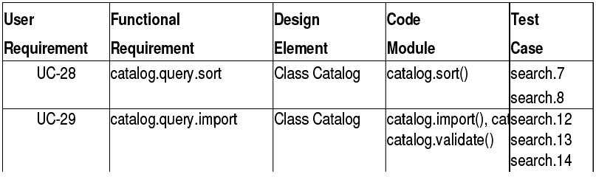
Representation – Traceability Table
Show the relationships between requirements or between requirements and other artifacts
Table can be set up to show links between several different elements
Backward and forward traceability
Difficult to capture different types of links

Slide 41
Representation – Traceability Matrix
Define links between pairs of elements
E.g., requirements to requirement, use case to requirement, requirement to test case…
Can be used to defined relationships between pairs
E.g., specifies/is specified by, depends on, is parent of, constrains…
More amenable to automation than traceability table
Depends-on
 | R1 | R2 | R3 | R4 | R5 | R6
R1 |  |  | * | *
R2 |  |  |  |  | * | *
R3 |  |  |  | * | *
R4 |  | *
R5 |  |  |  |  |  | *
R6

Slide 42
Representation – Traceability List
Traceability matrices become more of a problem when there are hundreds or thousands of requirements as the matrices become large and are sparsely populated
A simplified form of a traceability matrix may be used where, along with each requirement description, one or more lists of the identifiers of related requirements are maintained
Requirement | Depends-on
R1 | R3, R4
R2 | R5, R6
R3 | R4, R5
R4 | R2
R5 | R6

Slide 43
Traceability Planning
Planning traceability? - Yes, just like any other project!
Who are the stakeholders?
What are the needs (analysis, reports…)?
Useful, measurable, feasible objectives
Definition of links and attributes
Can some be inferred automatically?
Process (who collects and when to collect traceability information)
Roles, access
Data/link input and updates
Exceptional situations (e.g., lack of time)
Representations, queries, tools
…
Traceability policies define what and how traceability information should be maintained

Slide 44
Factors to Consider during Planning (1)
Number of requirements
The greater the number of requirements, the more the need for formal
traceability policies
Expected system lifetime
More comprehensive traceability policies should be defined for systems which have a long lifetime
Maturity level of organization
Detailed traceability policies are more likely to be implemented and used properly in a cost-effective way in organizations which have a higher level of process maturity
Size of project and team
The larger the project or team, the greater the need for formal traceability policies

Slide 45
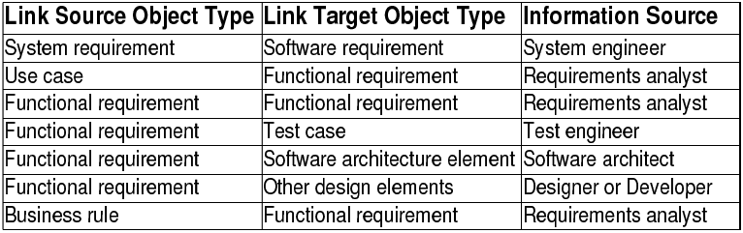
Factors to Consider during Planning (2)
Type of system
Critical systems such as hard real-time control systems or safety-critical systems need more comprehensive traceability policies than non-critical systems
Additional constraints from customer
E.g., compliance to military standard
Traceability links should be defined by whoever has the appropriate information available

Slide 46
Modeling Traceability
The types of links to use (and their attributes) must be defined for different types of requirements
It is a design problem!
May be modeled with a UML class diagram (metamodel)
Object types (classes)
Object attributes (attributes)
Structure of folders, modules, objects
Stereotypes, composition…
Link types (associations)
Satisfies, tests, refines, contains, contributes to, threatens, justifies…
Link attributes (association classes)
…

Slide 47
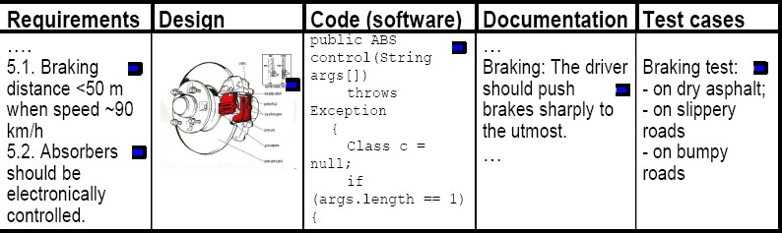
Types of Traceability Links
Note the types of links in the previous examples, as well as the types of objects they relate
Satisfies, Tests
Refines, References, Contains...
Others could be created
Contributes, Contradicts, Justifies, Depends on...

Slide 48
Other Example of Traceability Links
Business requirement
modifies
Drives specification of
System requirements, use case, external interface, quality attribute
Change request
modifies | Is
modifies
influences | Business rule
Is origin of
Is origin of
modifies
Software functional requirement
Depends on another
satisfied by
Is verified by
Lead to creation of
Architectrue,
user interface, or functional design
System test
Project plan task
Is verified by Is implemented in
Integration test
Code
Is verified by
Unit test

Slide 49
Cardinality of Traceability Links
Depending on the traceability information, the cardinality of traceability links may be
One-to-one
e.g., one design element to one code module
One-to-many
e.g., one functional requirement verified by multiple test
cases
Many-to-many
e.g., a use case may lead to multiple functional requirement, and a functional requirement may be common to several use cases

Slide 50
Chương 5. Các kỹ thuật nâng cao chất lượng yêu cầu phần mềm
V.1. Kiểm soát thay đổi yêu cầu phần mềm
V.2. Các thuộc tính chất lượng của yêu cầu phần mềm
V.3. Truy hồi yêu cầu phần mềm (tracing)
V.4. Quản lý thay đổi yêu cầu phần mềm
V.5. Một số công cụ quản lý thay đổi yêu cầu phần mềm
51

Slide 51
Change Management
Concerned with the procedures, processes, and standards which are used to manage changes to a system requirements
Change management policies may cover
The change request process and the information required to process each change request
The process used to analyse the impact and costs of change and the associated traceability information
The membership of the body that formally considers change requests
Software support (if any) for the change control process
A change request may have a status as well as requirements
E.g., proposed, rejected, accepted, included...

Slide 52
Change Management Process
Some requirements problem is identified
Could come from an analysis of the requirements, new customer
needs, or operational problems with the system
The requirements are analysed using problem information and requirements changes are proposed
The proposed changes are analysed
How many requirements (and, if necessary, system components) are
affected? Roughly how much would cost, in both time and money?
The change is implemented
A set of amendments to the requirements document or a new
document version is produced (of course this should be validated with
_{Identified}whatever normal quality checking procedures are in place)
problem
Problem analysis and change specification
Change analysis and costing
Change implementation
Revised requirements

Slide 53
Change Request Form
Proposed changes are usually recorded on a change request form which is then passed to all of the people involved in the analysis of the change
Change request forms may include
Date, Customer, Requester, Product including version
Description of change request including rationale
Fields to document the change analysis
Signature fields
Status
Comments

Slide 54








Change Analysis and Costing – Example
customers may misunderstand requirements and
their context and suggest unnecessary changes
with the help of traceability information
Rejected request
Change request
Check request
Find directly ^{Req. list}
risk is too high
affected requirements
Find dependent requirements
validity
Valid request
Requirements change list
Rejected request
Requirements
Cost information
Accept ed change
Propose requirements changes
changes
Assess costs of change
Assess cost acceptability
Rejected request
Rejected request
Customer information
Customer information
negotiations with customers
cost/time required for the implementation of change is too high/long
consequential changes may be unacceptable to user/customer
Source of figure: Kotonya and Sommerville

Slide 55
Different Management Aspects
Change Management
How does a customer submit change requests?
How is this request being monitored, prioritized, and implemented?
Configuration Management
Versioning, labelling, and tracking code and other components during the development cycle of software
Release Management
Defines how and when different hardware and software will be made available together as a product

Slide 56
Tool Support for Change Management
May be provided through requirements management tools or through configuration management tools
Tool facilities may include
Electronic change request forms which are filled in by different
participants in the process
A database to store and manage requests
A change model which may be instantiated so that people responsible for one stage of the process know who is responsible for the next process activity
Electronic transfer of forms between people with different responsibilities and electronic mail notification when activities have been completed
Electronic signatures
Discussion forums
In some cases, direct links to a requirements database

Slide 57
Chương 5. Các kỹ thuật nâng cao chất lượng yêu cầu phần mềm
V.1. Kiểm soát thay đổi yêu cầu phần mềm
V.2. Các thuộc tính chất lượng của yêu cầu phần mềm
V.3. Truy hồi yêu cầu phần mềm (tracing)
V.4. Quản lý thay đổi yêu cầu phần mềm
V.5. Một số công cụ quản lý thay đổi yêu cầu phần mềm
58

Slide 58
Additional Information Requirements Management Tools

Slide 59
What Kind of Tool Do We Need?
Different companies will use different tools, which may or may not be tailored to the requirements management task
Word processor (Microsoft Word with templates…)
Spreadsheet (Microsoft Excel…)
Industrial-strength, commercial RM tools
IBM/Telelogic DOORS, IBM Requisite Pro, Borland CaliberRM…
Internal tools
GenSpec (Hydro-Quebec)…
Open source RM tools
OSRMT: http://sourceforge.net/projects/osrmt
Bug tracking tools (free or not)
Bugzilla…
Collaboration tools (free or not)
TWiki…

Slide 60
What Should We Look For in a Tool?
Types/attributes for requirements and links
Specifications and models
Version and change management
Database repository
Traceability
Analysis (impact, completeness, style, differences…)
Automatic inspection of requirements (according to rules)
Visualization and reports
Requirements document generation
Monitoring of requirements statuses
Access control
Import/export
Communication with stakeholders
Scripting language (for automation)
Reuse of requirements,
models, projects
…

Slide 61
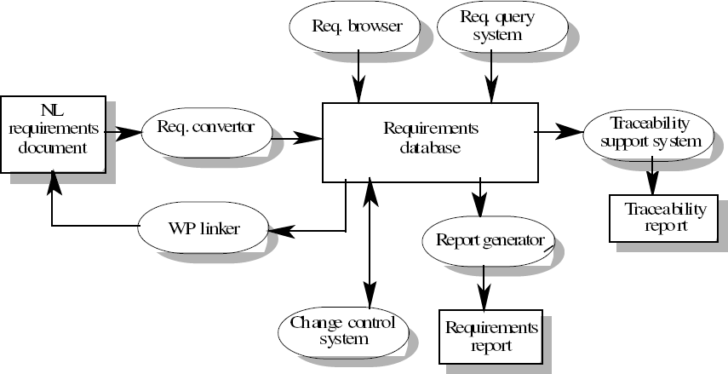
RM Tool Architecture – Example

Slide 62
Requirements Management Implies Integration!
Project-tracking tool
Test management tool
Version control tool
Requirements management tool
Change- request tool
Design modeling tool
Project estimation tool

Slide 63
Approaches – Document or Database? (1)
Requirements have to be stored in such a way that they can be accessed easily and related to other requirements
Document (e.g., Word)
Easy to use, easy to access, simple training
Requirements are all stored in the requirements document
It is easy to produce the final requirements document
But: Traceability? Status reports? Granularity of requirements? Search and navigation facilities? Change management? Version control? Analysis? Simultaneous access control?...

Slide 64
Approaches – Document or Database? (2)
Database (e.g., DOORS)
Good for management, controlled access, links, analysis, reports
Good query and navigation facilities
Support for change and version management
But: hard (and costly) to configure, manage, and use; link between the database and the requirements document must be maintained (final requirements document must be generated)
Ideally: Target the benefits of both
E.g., DOORS and RequisitePro offer integrations with Word (import/export) as well as document-oriented views⁶⁵(for the “look and feel”…)

Slide 65
How About Evolving the Process Itself?
Evolution of requirements types
Adding / modifying / deleting
Attributes
Link types
Requirements status
…
Evolution of change management
Adding / modifying / deleting
Attributes
Lifecycle status
Forms
…

Slide 66
Thinking About Getting a RM Tool?
The list of potential criteria and the list of products can be rather long…
See the INCOSE study: http://www.incose.org/ProductsPubs/Products/rmsurv ey.aspx
About 25 tools and 80 criteria, with explanations
Which are relevant to you, in your context (project, organization…)?
Need a goal model to define criteria and for assessment!

Slide 67
TWiki Overview
A generic Wiki tool (TWiki.org)
Promotes collaboration
Database-driven
Access and version control
Forms and queries
State-based workflows (processes)
Text and graphics
Lightweight, extensible (plug-in architecture)
Example of Forms and Queries
Requirements: http://cserg0.site.uottawa.ca/twiki/bin/view/ProjetSEG/UCMNavRequirements
Library: http://cserg0.site.uottawa.ca/twiki/bin/view/UCM/UCMVirtualLibrary
Use Cases: http://cserg0.site.uottawa.ca/seg/bin/view/CSI4900/UseCases

Slide 68
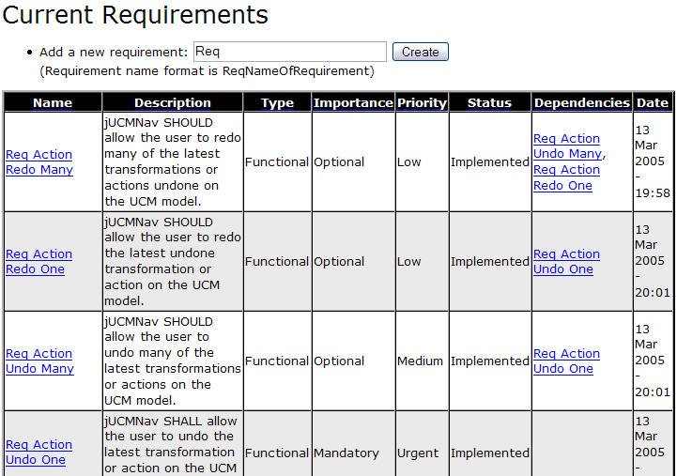
TWiki for Requirements Management

Slide 69
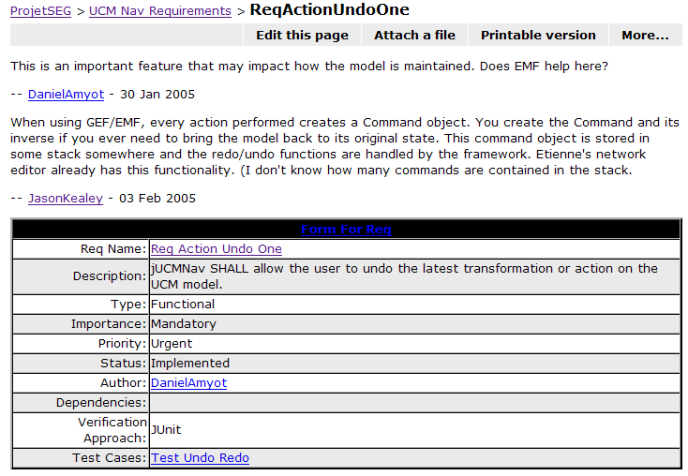
Twiki – Requirement Example

Slide 70
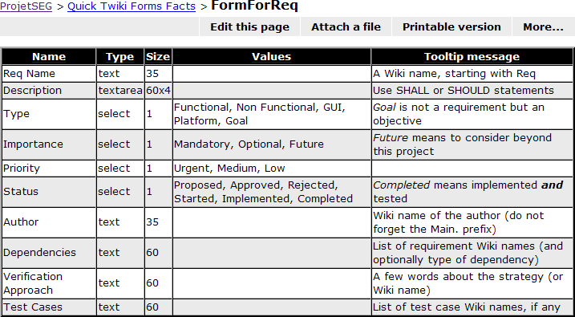
TWiki – Requirement Form Example

Slide 71
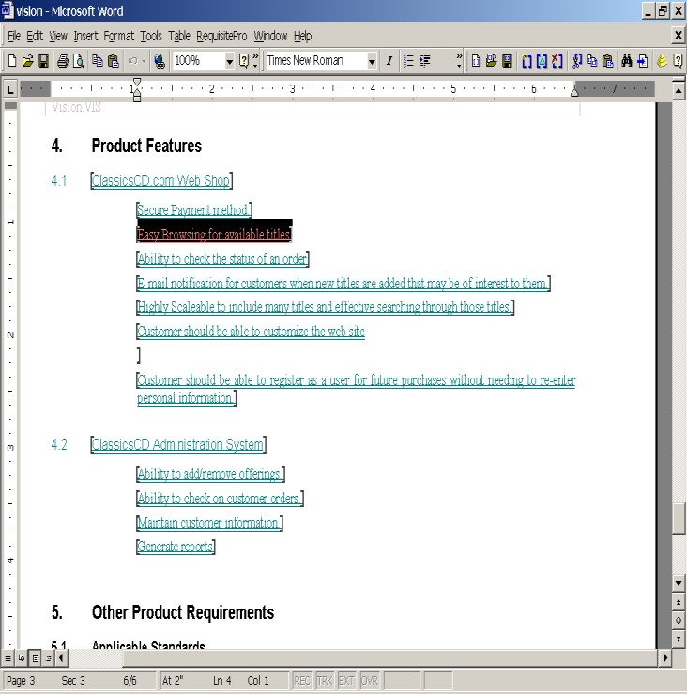
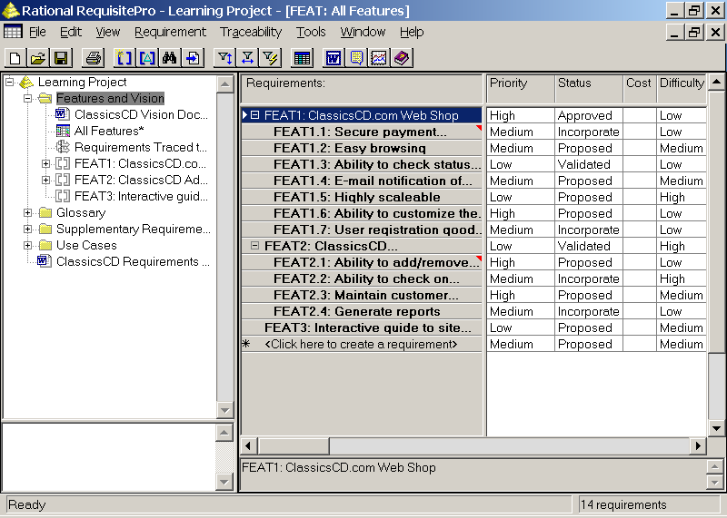
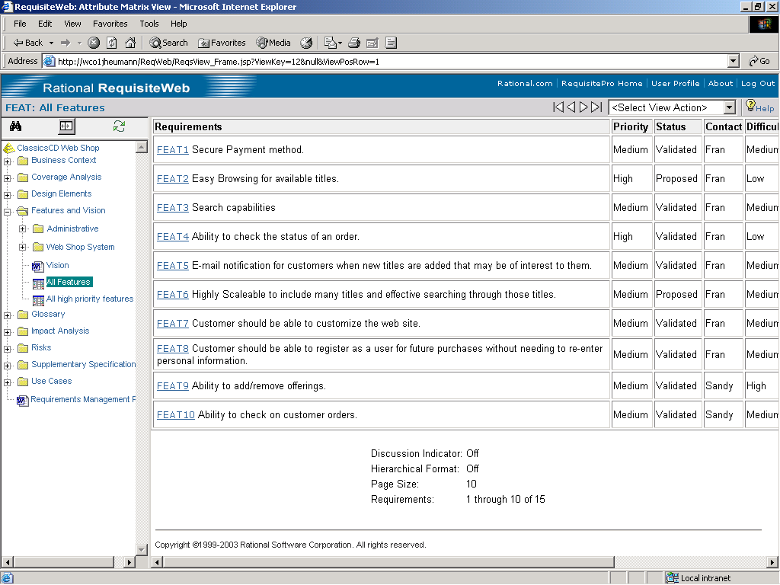



IBM Requisite Pro
Keep your team on track
Microsoft Word
Database
3 interfaces - work the way you want
Document centric or database centric - your choice
Web

Slide 72
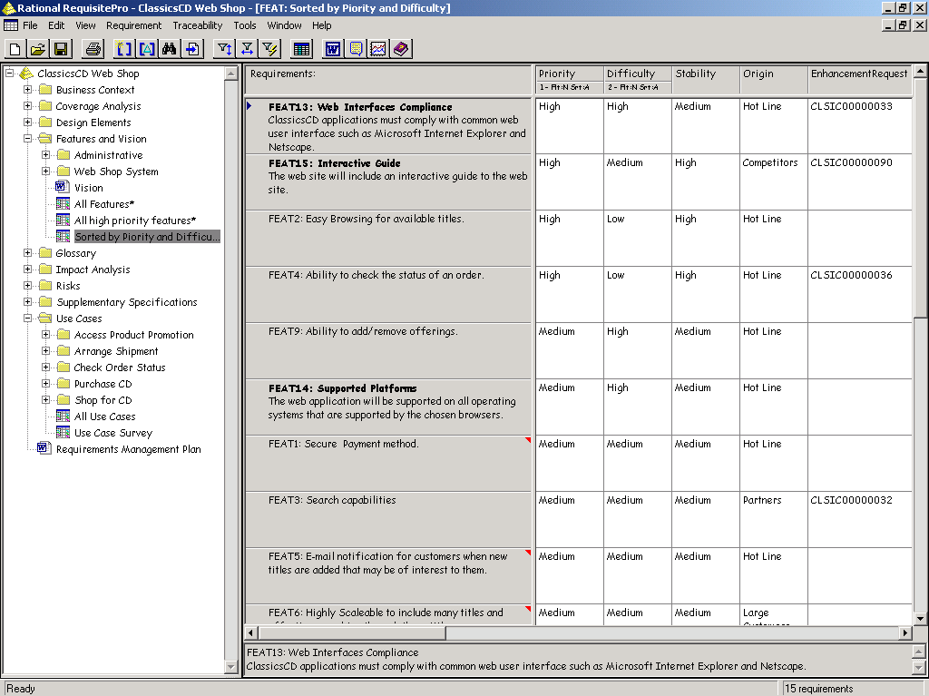
IBM Requisite Pro – Types, Attributes, and Views
User defined requirement
types
User defined attributes
User defined filters (views)
Saved views

Slide 73
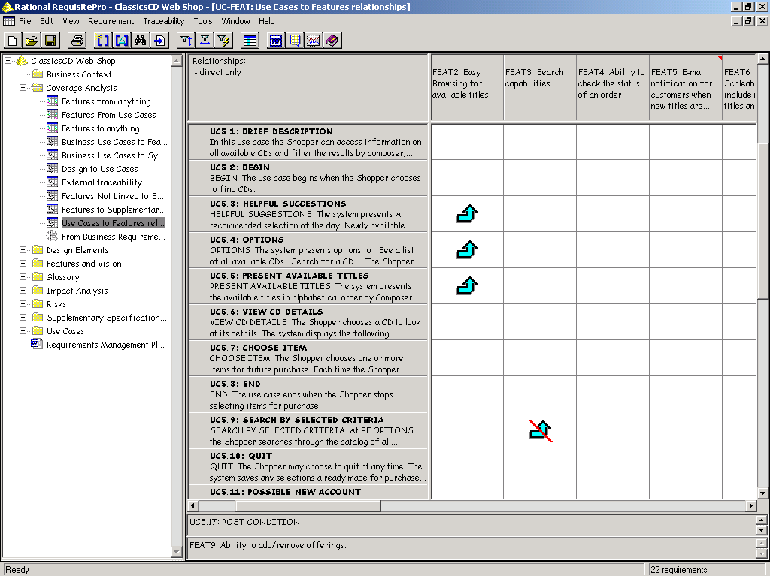
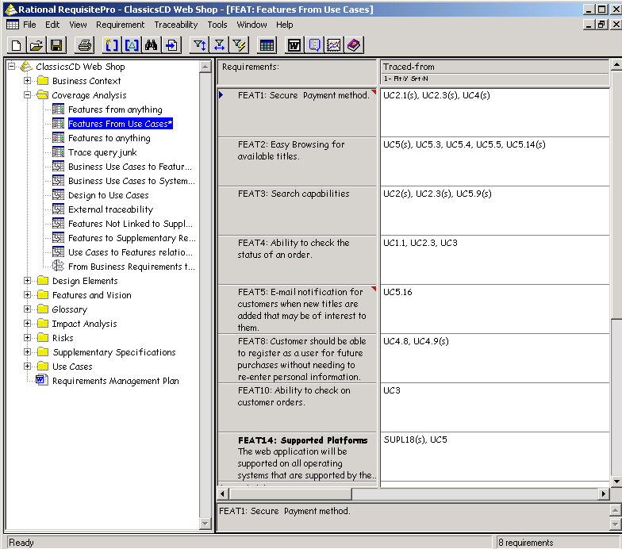
IBM Requisite Pro – Traceability

Slide 74


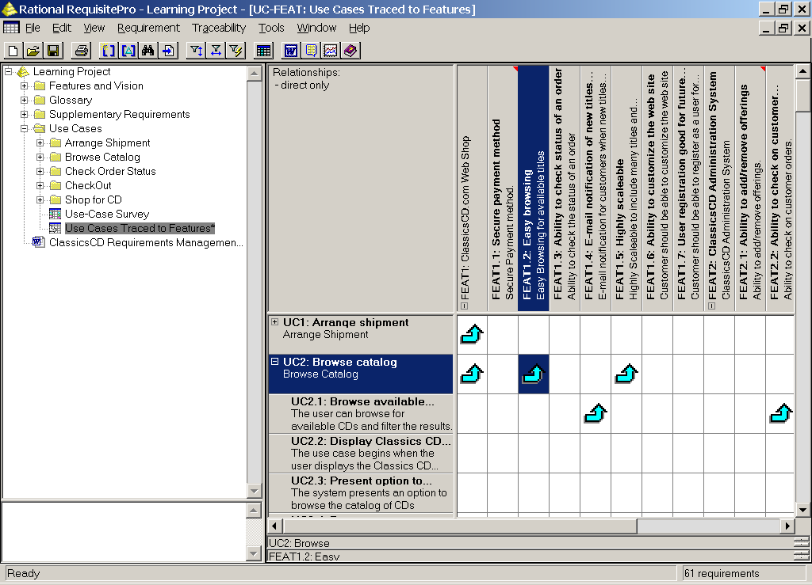

IBM Requisite Pro – Change Management

Slide 75
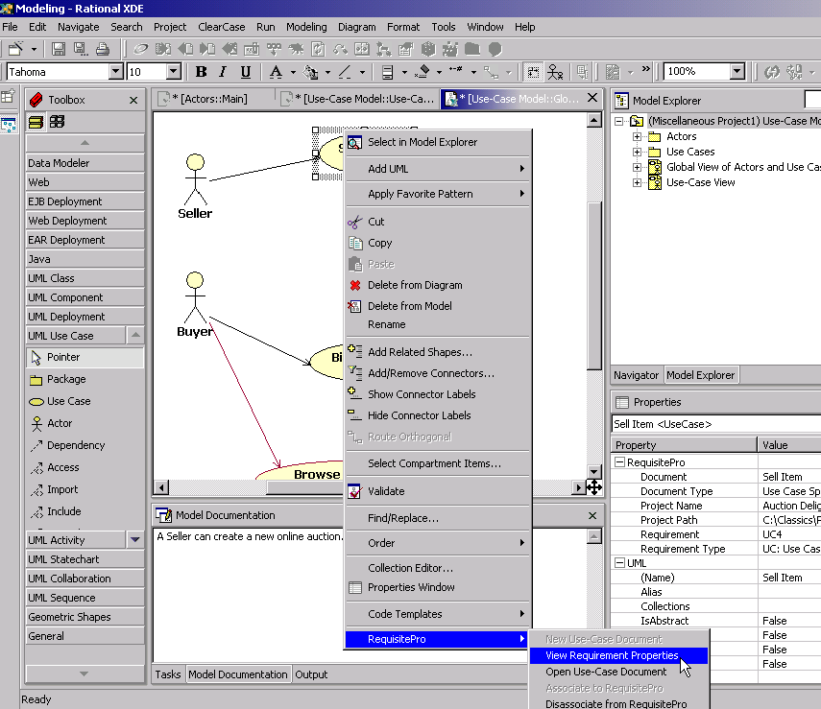
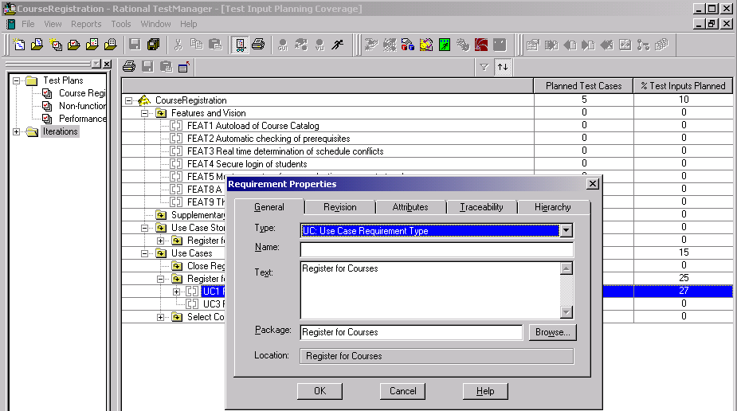
IBM Requisite Pro – Integration
IBM Rational TestManager
Testers view current state
of requirements from their tool
IBM Rational XDE and IBM Rational Rose, Rational Software Architect and Rational Software Modeler
Developers view current state of requirements from their tool

